Slide 1

Crime Trends in the Atlanta Area
The DATAMANIACS:
Kelly Cash, Joe Kim, Betsy James, Grace Sun, Sophie Qiao

Slide 2


Overview
Do any general trends exist regarding crime in the Atlanta area?
Overall amount of crime
Types of crimes committed
Seasons of the year
Months of the year
Time of day
Neighborhoods
Did general trends change in 2020 during the pandemic?

Slide 3

Data Cleanup & Exploration
Data obtained from Atlanta Police Department (https://www.atlantapd.org/) Raw Crime Data Download (2009-2020)
Cleaning process
Challenges
Three csv files across years
Unmatching columns/headings
Formatting: dates, times
Bad data
Years
Duplicates
Uncooperative cells

Slide 4
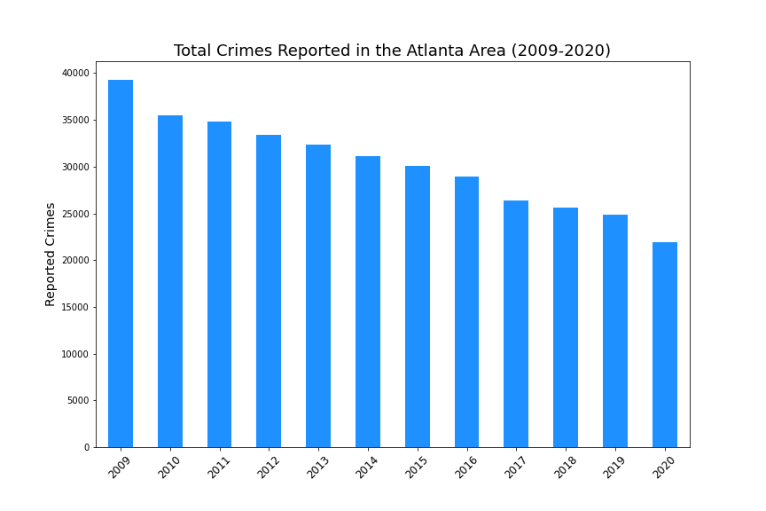
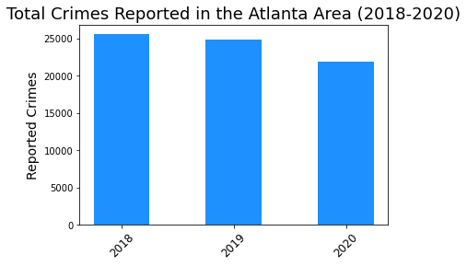
Overall crime trends 2009-2020
Multiple slides here of our graphs and cool findings

Slide 5
Bar chart crime types – violent & nonviolent 2018-2020

Slide 6
Seasons 2018-2020

Slide 7
Months 2018-2020

Slide 8
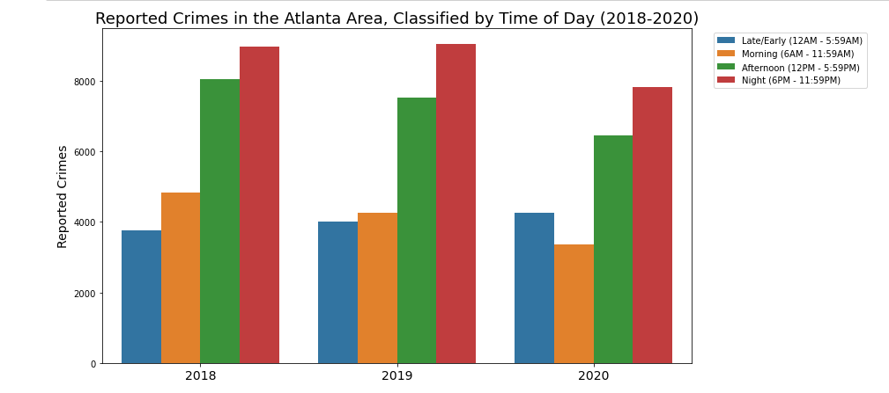
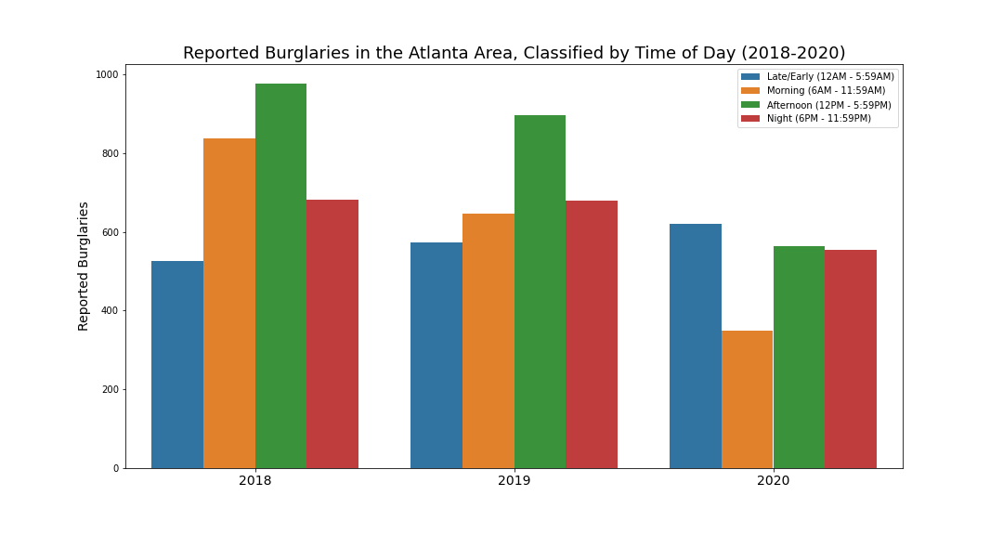

Slide 9
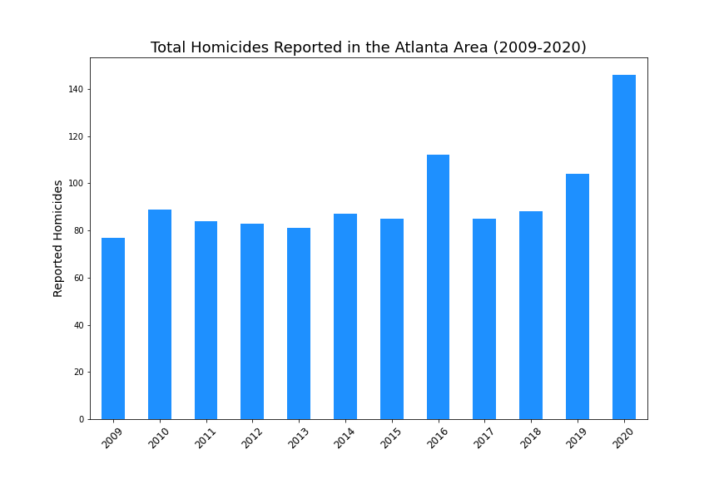
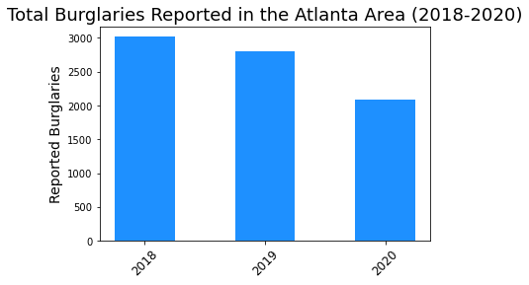
Homicides & Burg (change to 2018-2020)

Slide 10
Neighborhoods

Slide 11
Discussion/Conclusions

Slide 12

If we had more time, we would…
List of things we didn’t have time to discuss here…

Slide 13

Questions

Slide 14
